Slide 1
Who are Present Today
Justin, Tyler, Zach, Kaya, Tommy, Matt

Slide 2
Justin - Work
Helping Kaya with integrating the EVs into the grid, adding a second DSS Docker to do final EV computation
Completed the frontend so it actually works well
Added an archive mode to the Frontend
While it doesn’t have correct data yet, it does work with dummy data.

Slide 3
Tyler - Work
Played around a little more in OpenDSS to see the effects of line tripping and how the grid responds to various lines being tripped.
Started working on the final slide deck, though I think we as a team were confused last week on whether you wanted a mock presentation this week or not.
Helped Zach and Justin get the frontend more up to date and accurate with the direction we are going with the attacks.
Helped Justin and Zach see if there was a way to speed up the simulation (simulation runs on 1 singular core, trying to up that to at least 4 cores)

Slide 4
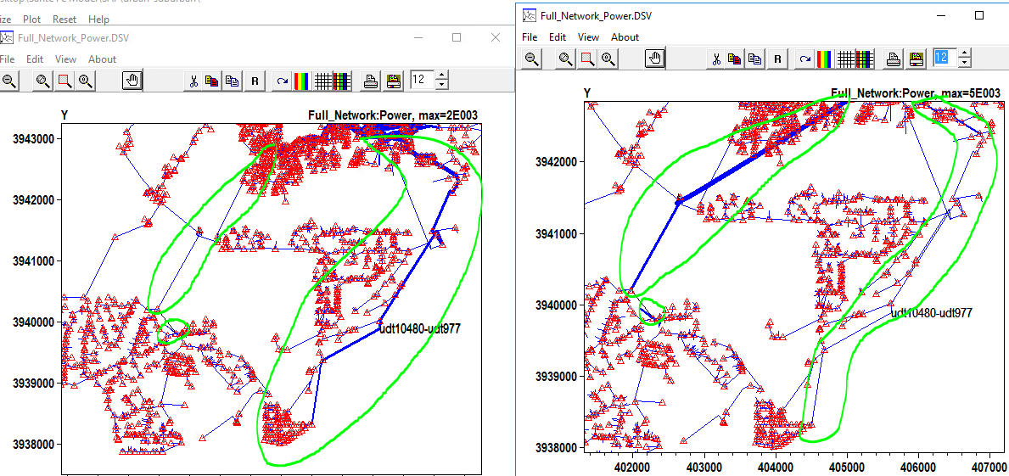
Tyler - Work
Line uhs1_69-uhs7_69: first is line disabled, second is line enabled

Slide 5
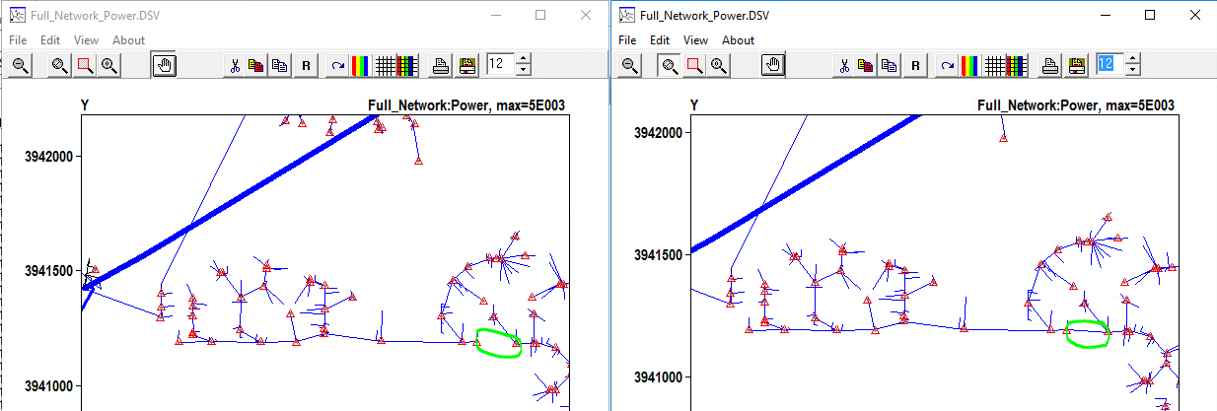
Tyler - Work
Line udt10773-udt2185: after (left) and before (right). ???

Slide 6
Tyler - Work
List of lines:
High load/severity:
uhs1_69-uhs7_69
uhs1_69-uts1_69
uhs2_69-uhs3_69
Medium load/severity:
udt10535-uhs7_69
udt8907-udt8917
uhs2_69-uhs4_69
Low load/severity:
udt10773-udt2185
udt6134-udt8656
udt4481-udt4487
Lines were selected randomly by how “thick” the lines were on a high, medium, low scale (so high, medium, and low loads).
Future work: - Work on final presentation
- Help get the number of cores for the simulation up (to reduce time)
- Get the line tripping attacks integrated into the working simulation.

Slide 7
Zach - Work
Added author and description tags to scripts
Added onto Tyler’s descriptions with real world examples of the attacks we are simulating
Created a download page to download all of the files from the ran simulation
Minor tweaks to most of the homepage w/ Justin

Slide 8
Zach - This Week
Adding dynamic images to webpage
Finish download backend for download page
Prep for presentation

Slide 9
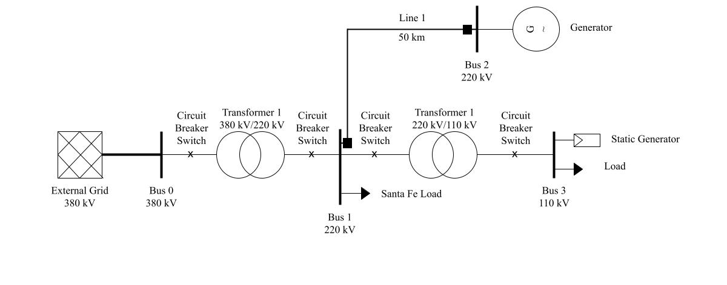
Tommy - Work
Completed Transmission Grid Model
Did research on DSS load Shape for EV implementation

Slide 10
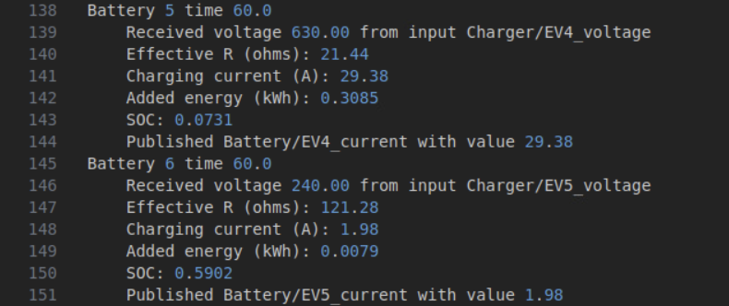
Tommy - Questions
For a DSS load we need to have one of the three set of parameters:
1. kW, PF
2. kw, kvar
3. kVA, PF
Helics EV only exports what is shown below… how do we input correct parameters for dss load?
|kV| * |Sum(i)| * cos(Θv - Θi) = P ⇒ kW
|kV| * |Sum(i)| * sin(Θv - Θi) = Q ⇒ kvar
i = ev current
We do not have Θv or Θi
How do we get these values from helics?
Possible solution: Use kW = |kV|*|Sum(i)| and assume PF=0.9 lagging
https://opendss.epri.com/Load1.html

Slide 11
Tommy - Future Work
Help with EV implementation on the DSS side
Help attack team with any problems/answer any questions
Document all work/finish video
Work on final presentation/poster
Help wherever is needed

Slide 12
Matt - Work
Worked with Kaya on EV load integration with DSS-python
Explored load shapes within DSS-python, it changed the values but the graph on our front end didnt change as much as we expected
Does the loadshape on the front end converge to a single value due to the Newton Raphson method that is used to simulate the power flow?
Used code to export the charger currents from HELICs as a CSV
Need to work more on the formatting of the data
Should I sum all charger currents if they are connected to a single load point?

Slide 13
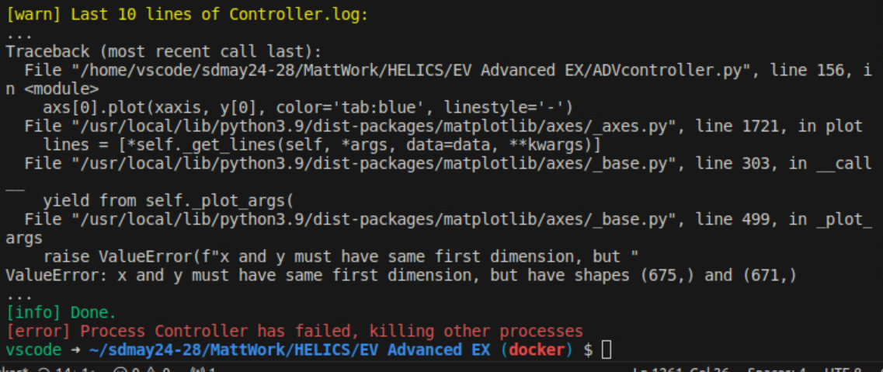
Matt - Work
After summing and extracting the currents, the plotting broke. Not sure what is happening here.

Slide 14
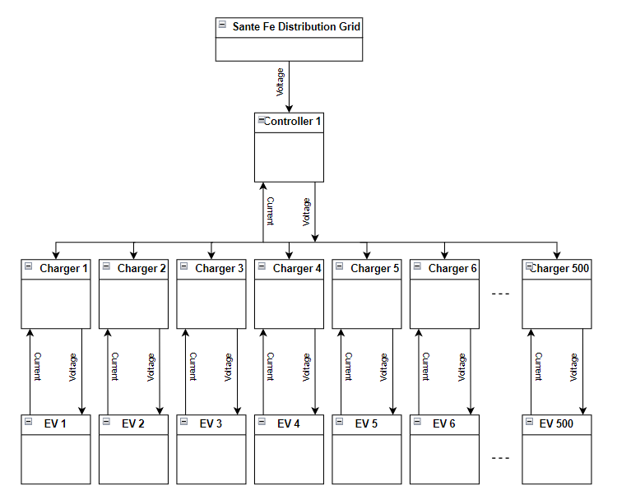
Matt - Work
Topological EV Load model

Slide 15
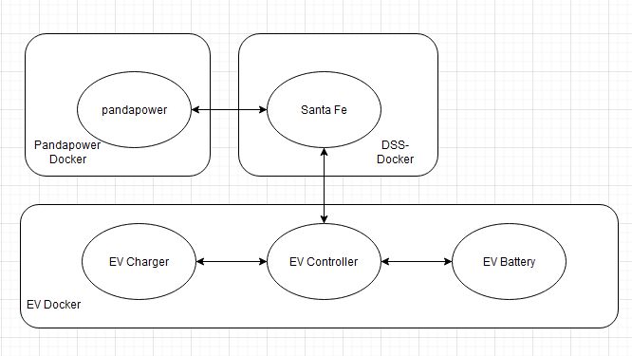
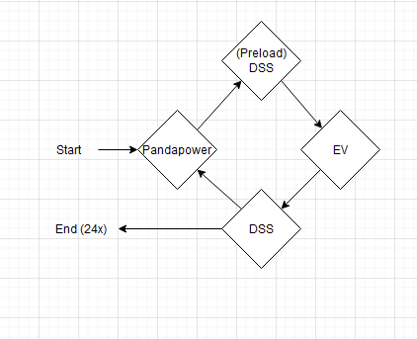
Kaya - Work
Worked with Justin finalize the graphs on the frontend.
Worked with Matt to implement the loadshape.
The shape of the graph is the same, however the values are just slightly lower, even though the load is being multiplied by values 0.4-1.4.
Worked with Justin to try and design a system to integrate the EVs.
Readme format question: by section, by person?

Slide 16
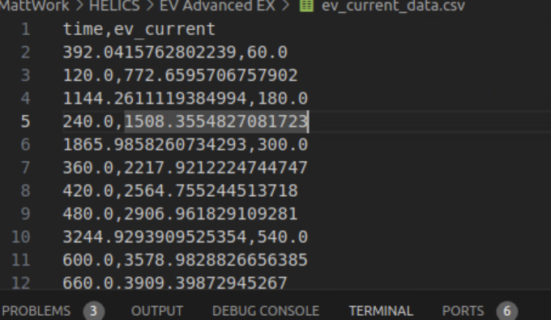
Kaya - Work
Helped Matt output EV data to csv. However the categories switch places occasionally? Possibly helics timing issue?

Slide 17
Kaya - Next Week
Work on documentation
Implement the python config settings file
Continue working on the EV integration
Work on the presentation

